Slide 1
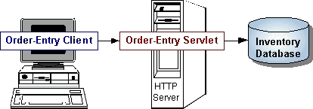
HTTP Servlet Overview
Servlets are modules that extend request/response-oriented servers, such as Java-enabled web servers. For example, a servlet might be responsible for taking data in an HTML order-entry form and applying the business logic used to update a company's order database.

Slide 2
Java Servlets
Java’s answer to CGI + ASP
A little more general than CGI/ASP, etc.
Work with all major web servers
Need web server servlet engine
Need servlet development kit

Slide 3
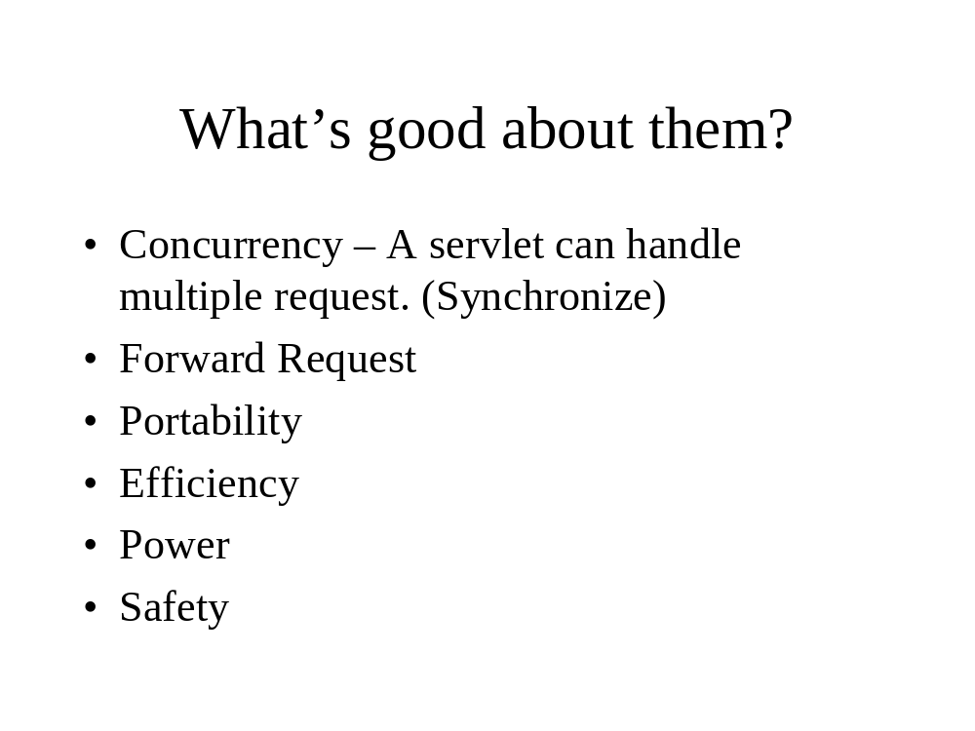

Slide 4
Types of Servlet
Generic Servlet
  javax.servlet (package)
  extends javax.servlet.Servlet
  service method
Http Servlet
  javax.servlet.http (package)
  extends javax.servlet.HttpServlet
  doget(), doPost()….

Slide 5
Types of servlets (cont..)
Generic servlet
  service(Request, Response) throws ServletException, IOException
HttpServlet
  doGet(HttpServletRequest req, HttpServletResponse res)

Slide 6
Basic Servlet example
import java.io.*;
import javax.servlet.*;
import javax.servlet.http.*;
public class Test extends HttpServlet{
public void doGet(HttpServletRequest in, HttpServletResponse out) throws ServletException, IOException {
out.setContentType(“text/html”);
PrintWriter p = res.getWriter();
p.println(“<H1>HELLO, WORLD!</H1>”);
}
}

Slide 7
POST Example
import java.io.*;
import javax.servlet.*;
import javax.servlet.http.*;
public class Test extends HttpServlet{
public void doGet(HttpServletRequest req, HttpServletResponse res) throws ServletException, IOException {
res.setContentType(“text/html”);
PrintWriter out = res.getWriter();

Slide 8
String pin = req.getParameter(“to”);
String orig = req.getParameter(“from”);
out.println(“Sending page to “ + pin + “ from “ + orig);
  // Actually send the page.
}
public void doPost(HttpServletRequest in, HttpServletResponse out) throws ServletException, IOException {
doGet(in, out);
}
}

Slide 9
Counter example
import ….;
public class SimpleCounter extends HttpServlet {
int count =0 ;
public void doGet( …….) throws ….
{
res.setContentType(“text/plain”);
PrintWriter out = res.getWriter();
count ++;
out.println(“Hit number: “+count);
}
}// end of class

Slide 10
What is the problem with the above example??

Slide 11
Synchonized counter
import ….;
public class SimpleCounter extends HttpServlet {
int count =0 ;
public void doGet( …….) throws ….
{
res.setContentType(“text/plain”);
PrintWriter out = res.getWriter();
synchonize(this) {
count ++;
out.println(“Hit number: “+count);
}
}
}// end of class

Slide 12
Servlet Life Cycle
Initialize using init method
Servlet handles requests/clients
Server removes the servlet using destroy method

Slide 13
Servlets vs. Applets
Similarities
  Neither has a main()
  Both have init() and destroy()
  Both are part of a larger application made for the web

Slide 14
Servlets vs. Applets (cont..)
Dissimilarity
  Applets run on the client (browser) while servlets run on the HTTP server
  Applets are usually “crippled” in functionality, having limited ability to look at the local file system, establish network connections, etc.
  Servlets are generally built to handle multiple clients at once, whereas applets generally service one client at a time.
  Servlets handle HTTP request
  …

Slide 15
Reference
Sun’s website - http://java.sun.com/docs/books/tutorial/servlets/lifecycle/index.html

